Slide 1
Chapter 6- Making Decisions
MGCR 222 - Introduction to Organizational Behaviour
Maya Sharma

Slide 2
Learning Objectives
1. Identify the Need for a Decision
Importance of Identifying the Need to Make a Decision
2. Develop Alternative Responses
Recognize the Alternative Responses Decision Makers Can Follow One a Need For Decision Has Been Identified
3. Choose the Appropriate Alternative
Discuss the Key Factors In Choosing the Appropriate Alternative Decision
4. Implement the Choice
Describe How Decisions Are Implemented

Slide 3
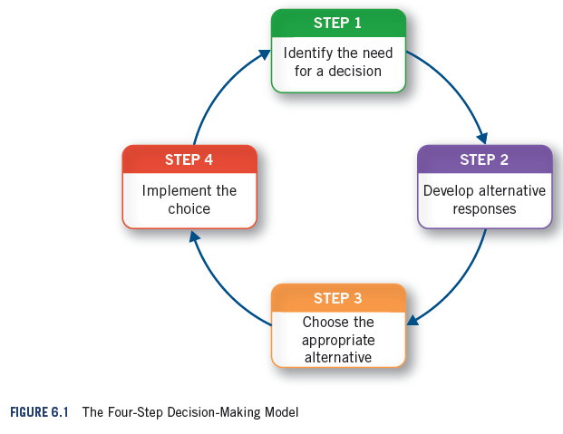
Copyright ©204 John Wiley & Sons, Inc.

Slide 4
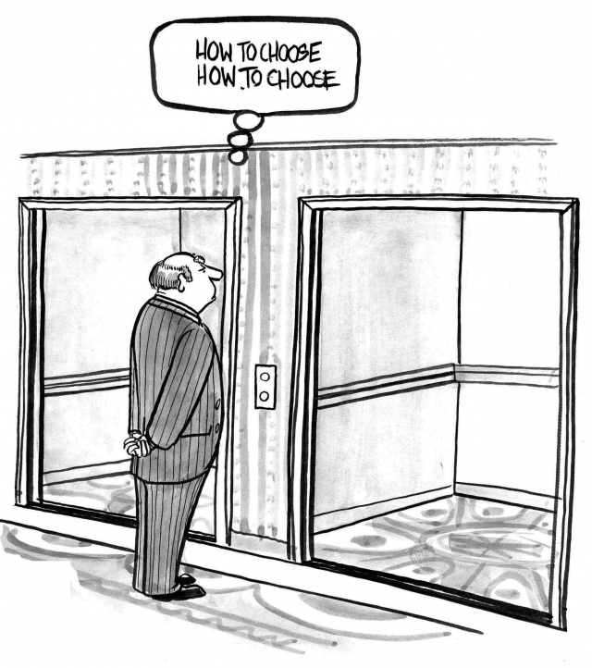
Step 1: Identifying The Need For a Decision
What is a decision?
Problems and opportunities in organizations call for decisions to be made.
Examples
Underlying Issues
Relevant Stakeholders
Sustainable approach

Slide 5

Step 2: Develop Alternative Responses
Basic Alternative Reponses
Choices When Making Decisions:
Do nothing
Programmed Decisions for repetitive and routine issues
Non-Programmed Decisions
Sustainable vs conventional

Slide 6
Step 3: Choose The Appropriate Alternative
Two Key Factors Drive The Choice
Goal Consensus: Low Versus High Goal Consensus
Affect criteria for making decisions
Available knowledge and uncertainty

Slide 7
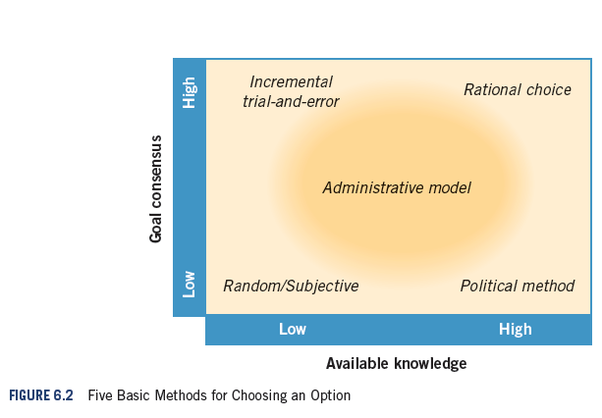
Copyright ©2014 John Wiley & Sons, Inc.

Slide 8
Step 3: Choose The Appropriate Alternative
Satisficing and Framing
Subjective Effects of Decisions on Employee Appraisals
Halo/Horn Effect, Availability Bias, etc..
Explicit & Tacit Knowledge

Slide 9
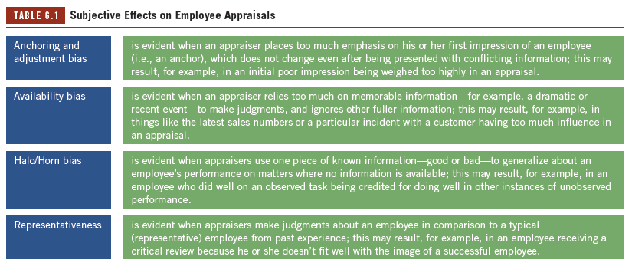

Slide 10


How Do Managers Actually Make Ethical Decisions?
Image Theory
Compatibility Test
Pro-fit-ability Test
Tweet/Facebook test

Slide 11
Step 4: Implement The Choice
Overcoming Resistance
4 methods to overcome resistance
What Are the Factors That Influence The Appropriate Level of Participation in Decisions Making and Implementation?

Slide 12
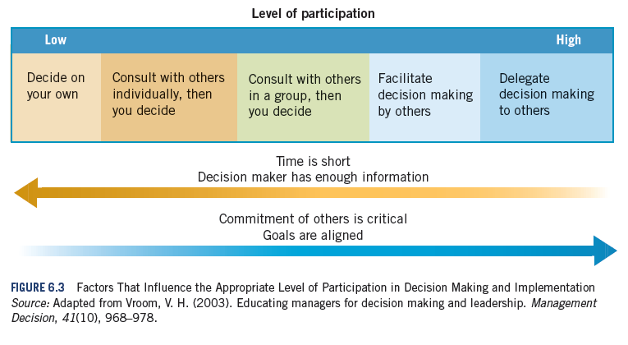
Copyright ©2014 John Wiley & Sons, Inc.

Slide 13
Escalation of Commitment
Factors Contributing to Escalation of Commitment:
Information Distortion
Blind persistence
Faulty reasoning
Administrative Inertia
Addressing Escalation of Commitment: see decisions as information rather than legacy, undo bad decisions, etc.

Slide 14

Sustainable Approach to Reducing Escalation of Commitment
Participation in all four steps of the decision-making process
Decisions are experiments, we learn from them.
Requires a healthy dose of
Courage!

Slide 15
Key Terms
Administrative method:
of decision making is evident when decision makers usually have some knowledge and at least partial goal consensus.
Administrative inertia:
describes what happens when existing structures and systems persist simply because they are already in place.
Decision:
is a choice that is made among a number of available alternatives.
Escalation of commitment:
occurs when a decision maker perseveres with the implementation of a poor decision despite evidence that it is not working.
Explicit knowledge:
is information that can be articulated or codified.
Framing:
refers to presenting ideas and alternatives in a way that has an influence on the choices that people make.
Goal consensus:
is the level of agreement among members about which goals the organization should pursue.
Image theory:
describes decisions as being made not “by the numbers,” but in comparison with ideal states or ideal images of self or outcomes.

Slide 16
Key Terms
Incremental trial-and-error method:
of decision making is evident when decision makers have high agreement on goals but a low level of technical knowledge.
Information distortion:
refers to the tendency to overlook or downplay feedback that makes a decision look bad and instead to focus on feedback that makes the decision look good.
Intuition:
refers to making decisions based on tacit knowledge, which can be based on experience, insight, hunches, or “gut” feelings.
Nonprogrammed decisions:
involve developing and choosing among new alternatives in situations where programmed alternatives have not yet been developed or are not appropriate.
Programmed decisions:
involve choosing a standard alternative in response to recurring organizational problems or opportunities.
Political method:
of decision making is evident when there is much debate about which goal to pursue, even though a lot of knowledge is available.
Rational choice:
as a method of decision making is evident when goal consensus is high and there is adequate time to collect all the required information.
Satisficing:
is evident when managers accept an adequate response to a problem or opportunity, rather than make the effort to develop an optimal response.
Scripts:
are learned frameworks that provide direction for people by helping them interpret and respond to what is happening around them.

Slide 17
Key Terms
Subjective method:
of decision making is evident when there is little or no agreement on goals and limited information.
Tacit knowledge:
is information people possess that is difficult to articulate or codify.
Uncertainty:
is evident when decision makers do not know what outcomes to expect with choosing a particular alternative.

Slide 18
Next Steps
Chapter 8- Understanding Relationships

